Slide 1


Linh Hoang
29/05/2023

Slide 2

Outline
Executive Summary
Introduction
Methodology
Results
Conclusion
Appendix

Slide 3
Executive Summary
Summary of methodologies:
This research is conducted to identify the factors for a successful rocket landing. There are several methodologies used in this research: Collect, wrangle, explore, analyze, explore, visualize and building models for predictions
Summary of all results:
Launch sites are near the coast but far from city
Orbits ES-L1, GEO, HEO ,SSO has 100% success rate
Launch success improved over time

Slide 4
Introduction
SpaceX is the most successful company when we talk about reusable rockets. Their accomplishments include: Sending spacecraft to the International Space Station, Starlink, a satellite internet constellation providing satellite Internet access,Sending manned missions to Space. Their launches are relatively inexpensive. Our company Space Y would like to compete with Space X to become the best company in this industry. In order to achieve that, as a scientist, I’m going to determine the price of each launch as well as will Space X be reusing the first stage rocket.

Slide 5

Section 1

Slide 6
Methodology
Executive Summary
Data collection methodology:
Data was collected using REST API
Perform data wrangling
Data is cleaned, filtered, handled missing data and applied one hot encoding
Perform exploratory data analysis (EDA) using visualization and SQL
Perform interactive visual analytics using Folium and Plotly Dash
Perform predictive analysis using classification models
Multiple models were used and GridSearchCV has been used to find the best parameters

Slide 7
Data Collection
Data were collected using API as well as web scraping
Requests and BeautifulSoup library used to get the data from sources
Data are extracted and filtered to our needs
Pandas DataFrame are used to store the data
Finally, data were exported to CSV files

Slide 8
Data Collection – SpaceX API
﻿﻿Request data from SpaceX API)
﻿﻿Decode response using json() and convert to a dataframe using json_normalize()
﻿﻿Using custom functions to get information about the launches from Space API
﻿﻿Create dataframe from the data
﻿﻿Filter dataframe to contain only Falcon 9 launches
﻿﻿Replace missing values of PayloadMass with calculated mean()
﻿﻿Export data to csv file
Here is the github link for further details: https://github.com/link271/coursera_capstore/blob/main/jupyter-labs-spacex-data-collection-api.ipynb

Slide 9
Data Collection - Scraping
Here is the GitHub link for further details: https://github.com/link271/coursera_capstore/blob/main/jupyter-labs-webscraping.ipynb
﻿﻿Request data from Wikipedia
﻿﻿Create BeautifulSoup object from HTML response
﻿﻿Extract column names from HTML table header
﻿﻿Collect data from HTML
﻿﻿Create DataFrame from the data
﻿Export data to csv file

Slide 10
Data Wrangling
Here are the steps:
-Perform EDA on the data to get the number of launches each site, occurrence of orbit and mission outcome per orbit
-Create binary landing outcome
Outcomes:
-Landing not always successful
-Success rate increase every year
Here is the GitHub link for references: https://github.com/link271/coursera_capstore/blob/main/IBM-DS0321EN-SkillsNetwork_labs_module_1_L3_labs-jupyter-spacex-data_wrangling_jupyterlite.jupyterlite.ipynb

Slide 11
EDA with Data Visualization
The following charts were created:
-Flight number vs payload and flight number vs launch site
-Payload mass vs launch site and payload mass vs orbit type
Purposes:
-Showing comparisons and view relationship between data columns
Here is the Github link for reference: https://github.com/link271/coursera_capstore/blob/main/IBM-DS0321EN-SkillsNetwork_labs_module_2_jupyter-labs-eda-dataviz.ipynb.jupyterlite.ipynb

Slide 12
EDA with SQL
Here are the queries:
Get the unique names of launch sites
Get 5 launch sites begins with CCA
Get total payload mass carried by NASA CRS
Get Date of first successful landing on groundpad
Get name of boosters with success drone ship landing and payload mass in range 4000-6000
Get average payload mass of booster f9v1.1
Get number of successful/failed missions
Get count of landing outcomes on specific dates
Get failed landing outcomes on drone ship and some data for the months in the year 2015
Here is the github for reference: https://github.com/link271/coursera_capstore/blob/main/jupyter-labs-eda-sql-coursera_sqllite.ipynb

Slide 13
Build an Interactive Map with Folium
Added circles and labels at launch sites and NASA
Added green/red markers at launch sies to show which launch sites have better success rate
Added line to show distance between launch site and nearest city, highway, rails, coastal to find the relationship
Here is the github link for reference: https://github.com/link271/coursera_capstore/blob/main/IBM-DS0321EN-SkillsNetwork_labs_module_3_lab_jupyter_launch_site_location.jupyterlite.ipynb

Slide 14
Build a Dashboard with Plotly Dash
-Added dropdown list with launch sites to allow users to select sites
-Added pie chart showing successful launches to allow users to see successful and unsuccessful launches
-Added slider of payload mass to allow users to select a range
-Added chart to show relationship between payload mass and success rate by Booster version
Here is the github link for reference: https://github.com/link271/coursera_capstore/blob/main/spacex_dash_app.py

Slide 15
Predictive Analysis (Classification)
-Standarized data using scaler
-Split the data using train_test_split
-Used gridsearchcv with cv=10 to find the best parameters
-Test with different models to get the best algorithms
-Calculate the accuracy
-Test with f1 score
Here is the github link: https://github.com/link271/coursera_capstore/blob/main/IBM-DS0321EN-SkillsNetwork_labs_module_4_SpaceX_Machine_Learning_Prediction_Part_5.jupyterlite.ipynb

Slide 16
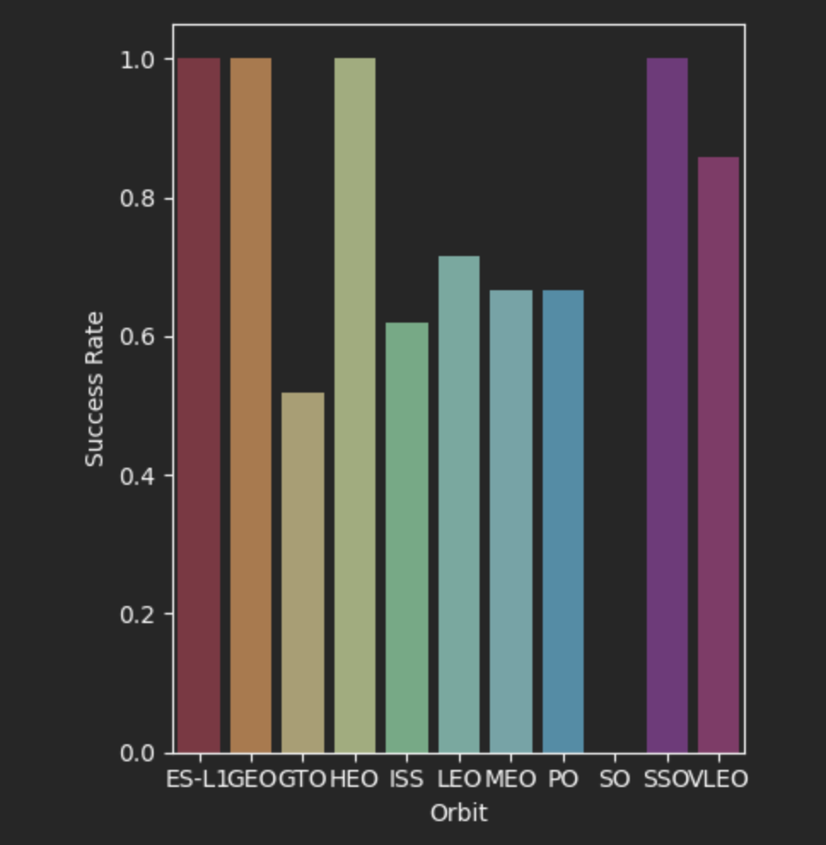
Results
Exploratory data analysis:
-Launch success rate has improved over time
-Orbits ES-L1,GEO,HEO and SSO have perfect success rate
-KSC LC-39A has the highest landing sites success rate
Predictive analysis results:
-All models perform the same with the test set

Slide 17

Section 2

Slide 18
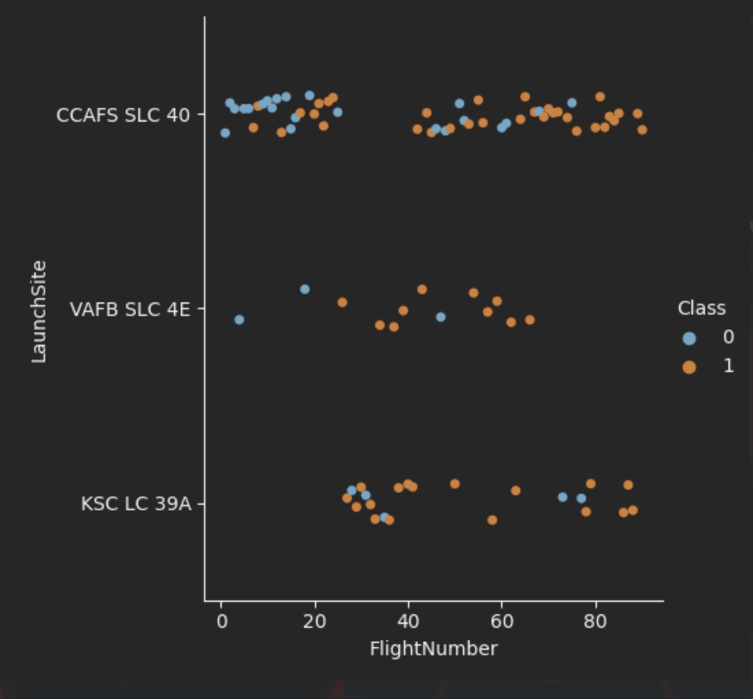
Flight Number vs. Launch Site
As you can see here, launch site VAFB SLC 4E has no flight number above 70
CCAFS SLC 40 has the most launches
KSC LC 39A has no flightNumber below 20

Slide 19
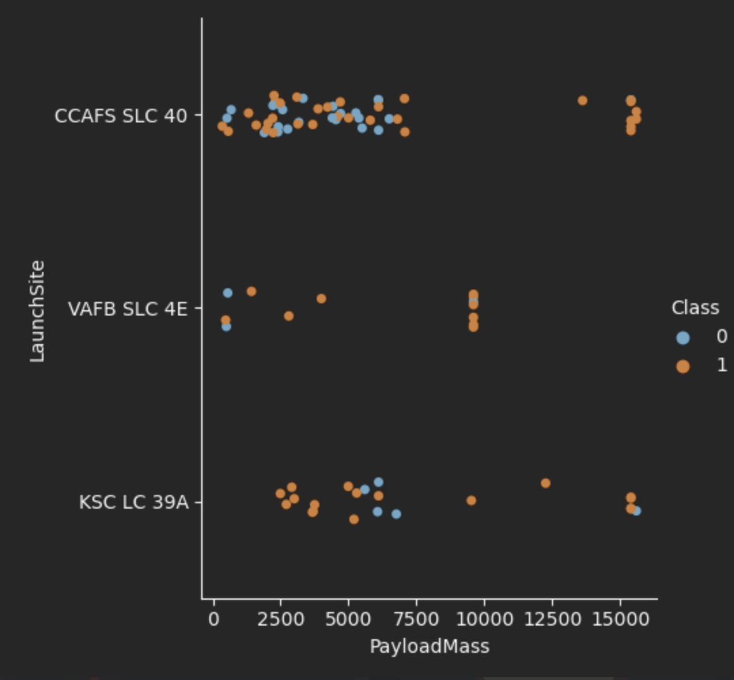
Payload vs. Launch Site
VAFB SLC 4E has no flight with payload above 10000
Most of CCAFS SLC 40’s payload are range from 0 to 7500
All high payload flights of CCAFS SLC 40 were succeeded

Slide 20
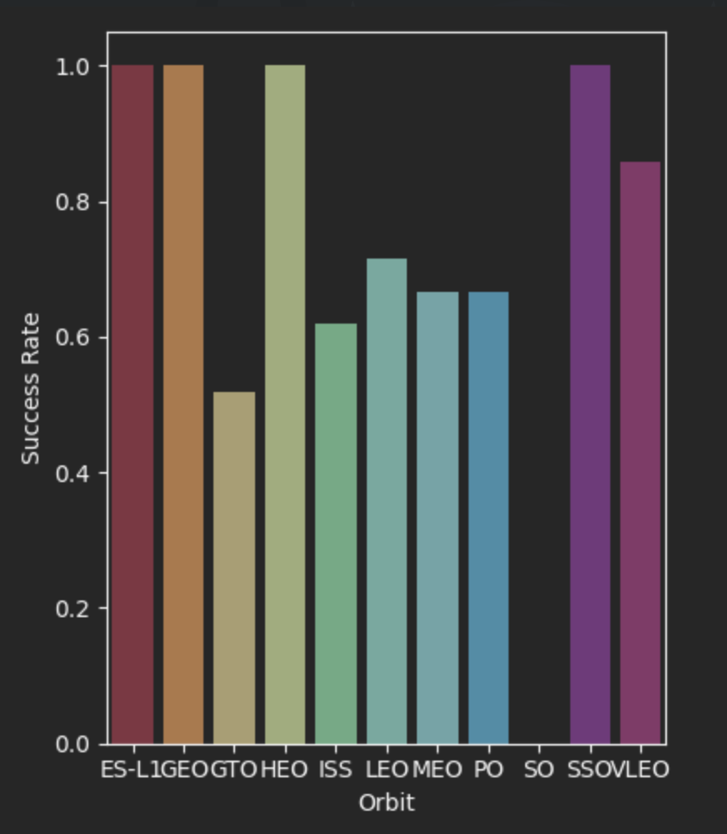
Success Rate vs. Orbit Type
Orbits ES-L1,GEO,HEO and SSO have 100% success rate
SO has 0% success rate

Slide 21
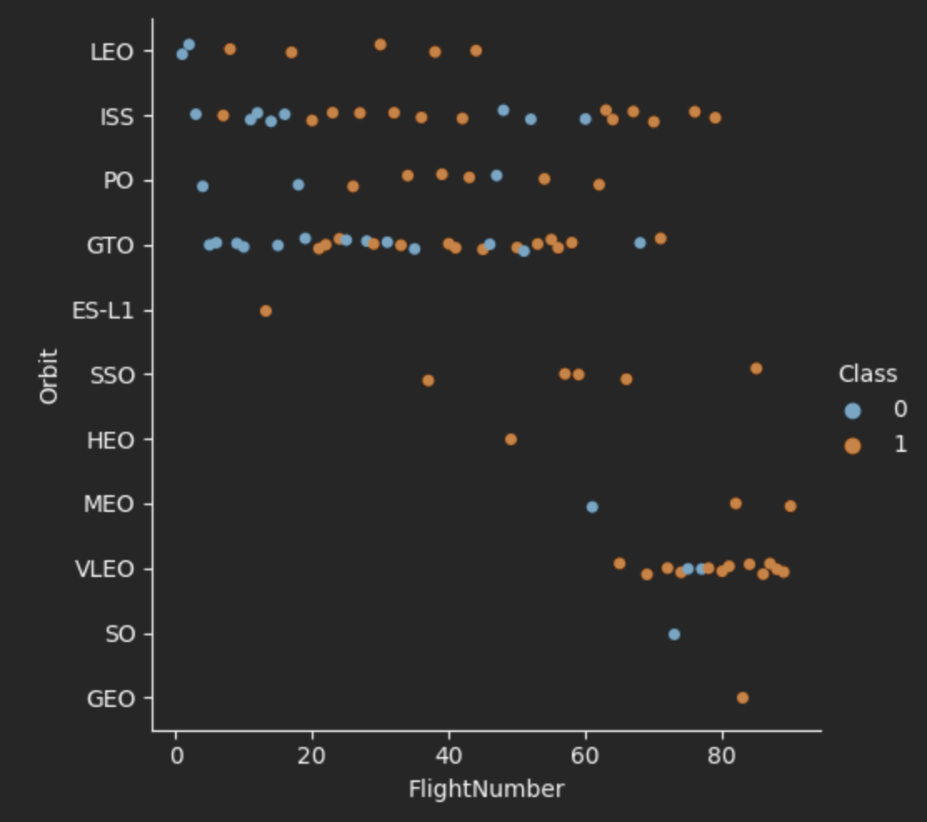
Flight Number vs. Orbit Type
There is only 1 flight to SO,GEO and ES-L1 orbit
ISS and GTO Orbit are the most popular orbits to launch

Slide 22
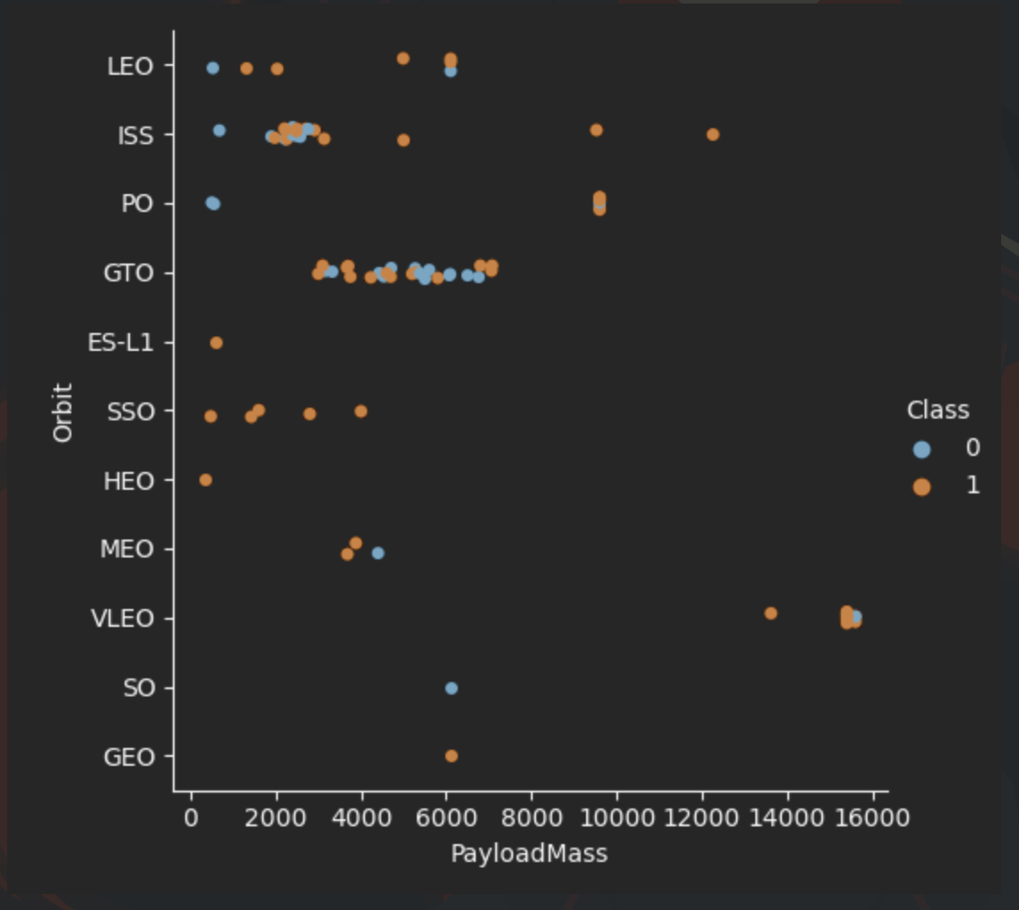
Payload vs. Orbit Type
Flights to VLEO Orbits carried the heaviest payload
Most of the flights to SSO carried a payload ranging from 0 to around 4000
Most of the flights to GTO carried a payload range between 4000 to 8000

Slide 23
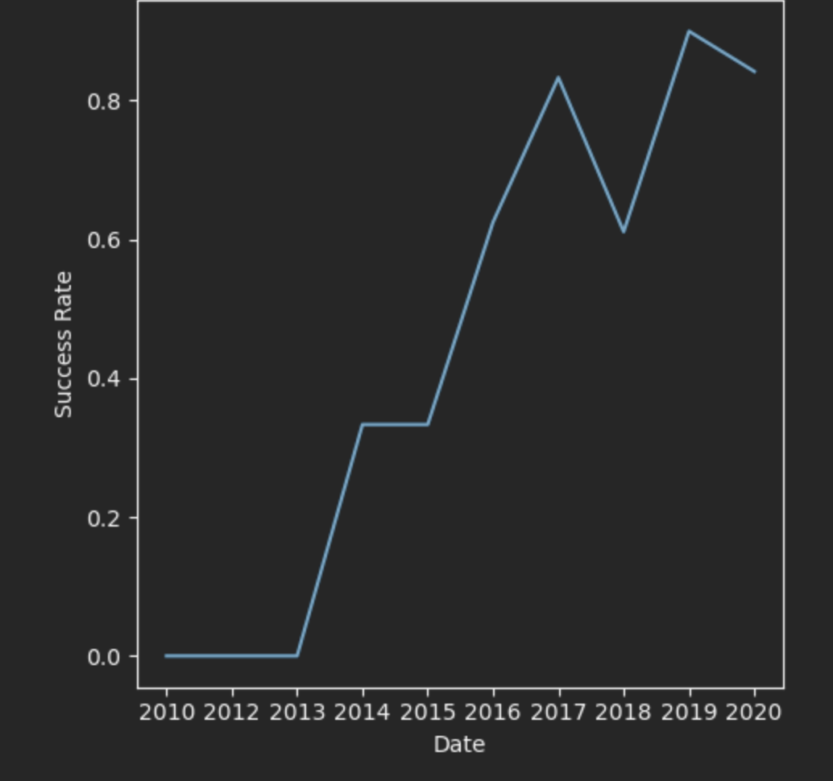
Launch Success Yearly Trend
Success rate increases throughout the years with a small decreases in 2018
Success rate decreased from 2019 to 2020
Flights from 2010 to 2013 have 0% success rate

Slide 24
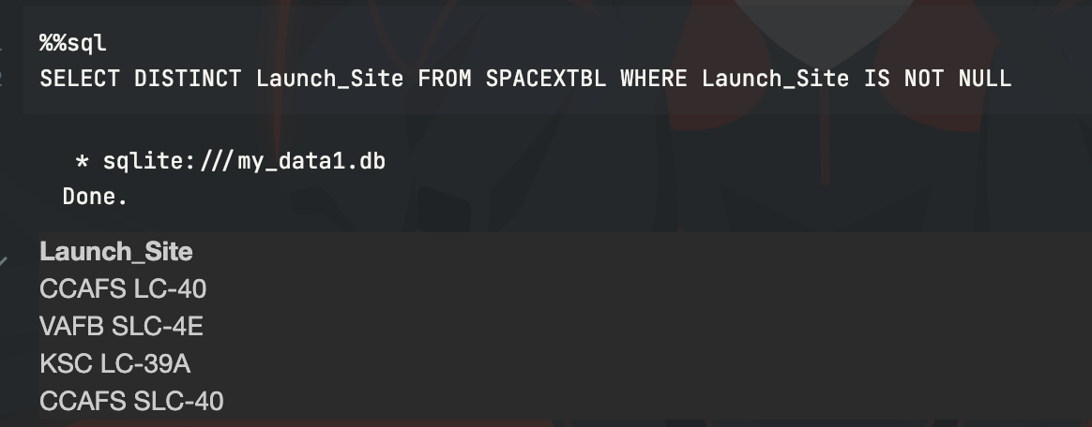
All Launch Site Names
Unique launch sites:
-CCAFS LC-40
-VAFB SLC-4E
-KSC LC-39A
-CCAFS SLC-40

Slide 25
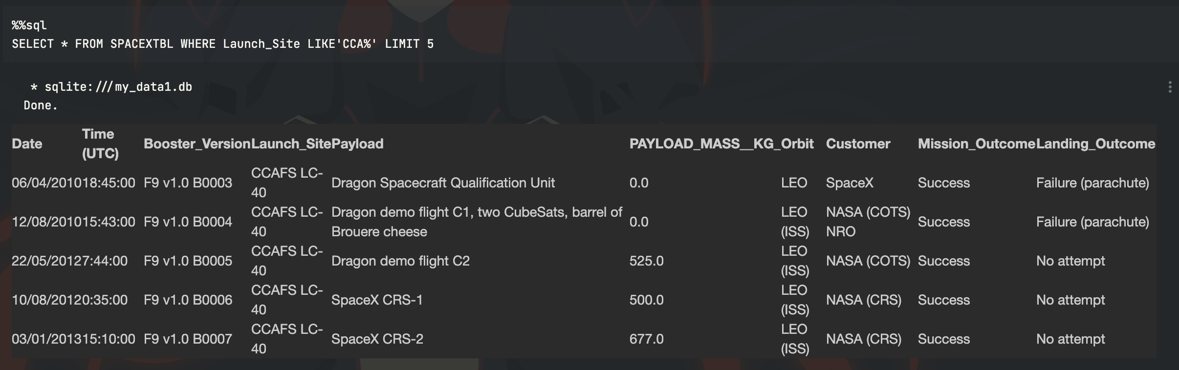
Launch Site Names Begin with 'CCA'
-Use limit 5 to get only 5 records from the table that start with CCA

Slide 26
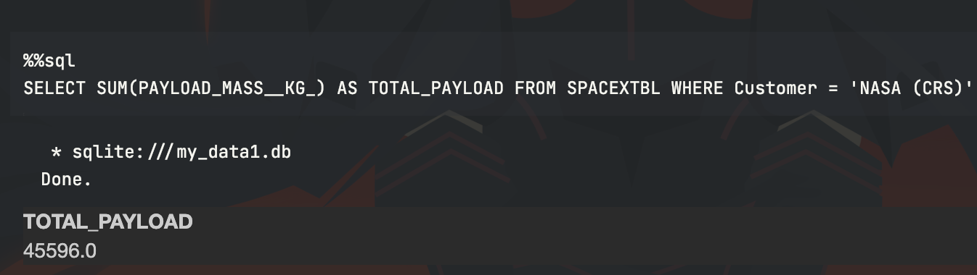
Total Payload Mass
-Use sum to get the total payload mass and where clause to get only the NASA CRS Boosters

Slide 27
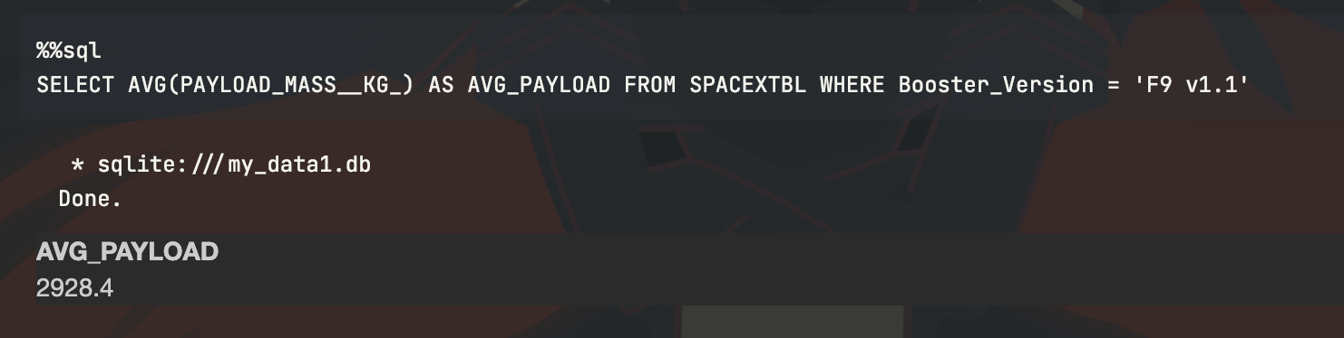
Average Payload Mass by F9 v1.1
-Use AVG to get the average payload mass and where condition to get data of F9 v1.1 only

Slide 28
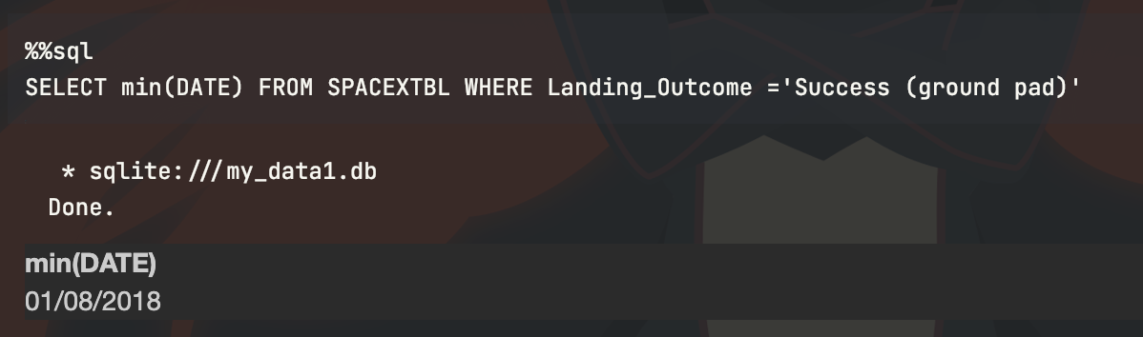
First Successful Ground Landing Date
-Use min(DATE) to get the minimum value of date and where condition to get mission with success ground pad

Slide 29
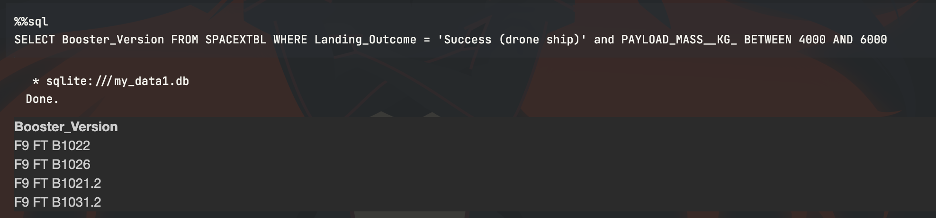
Successful Drone Ship Landing with Payload between 4000 and 6000
-Use between clause to get payload mass between 4000 and 6000

Slide 30
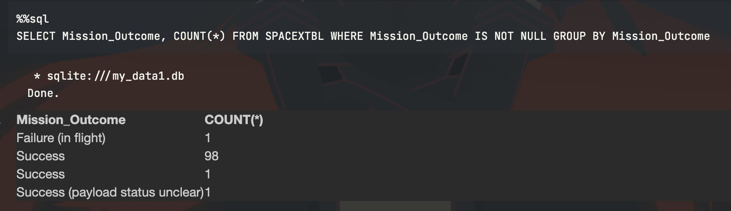
Total Number of Successful and Failure Mission Outcomes
-use group by to get number of successful and failure of mission outcomes

Slide 31
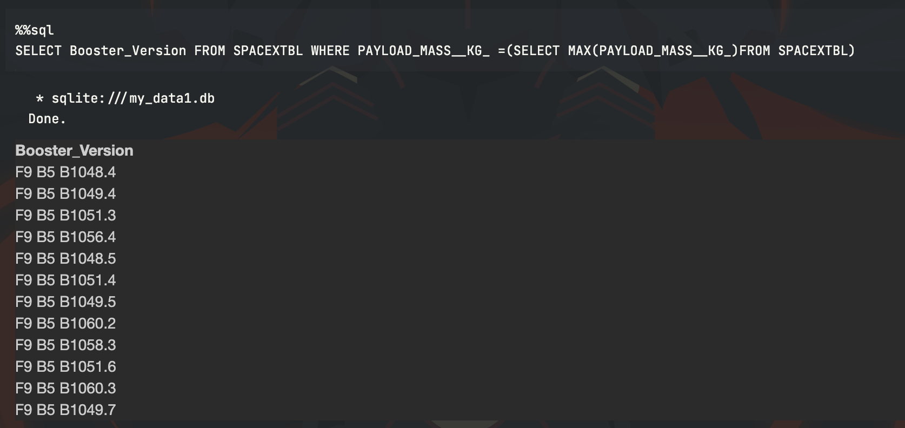
Boosters Carried Maximum Payload
-Use sub query to get max payload
mass value from the dataset

Slide 32
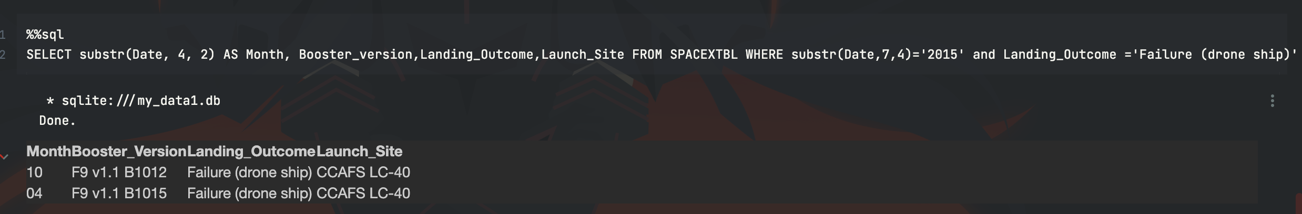
2015 Launch Records
-There are 2 launched in october and april failed in drone ship at launch site CCAFS LC-40

Slide 33
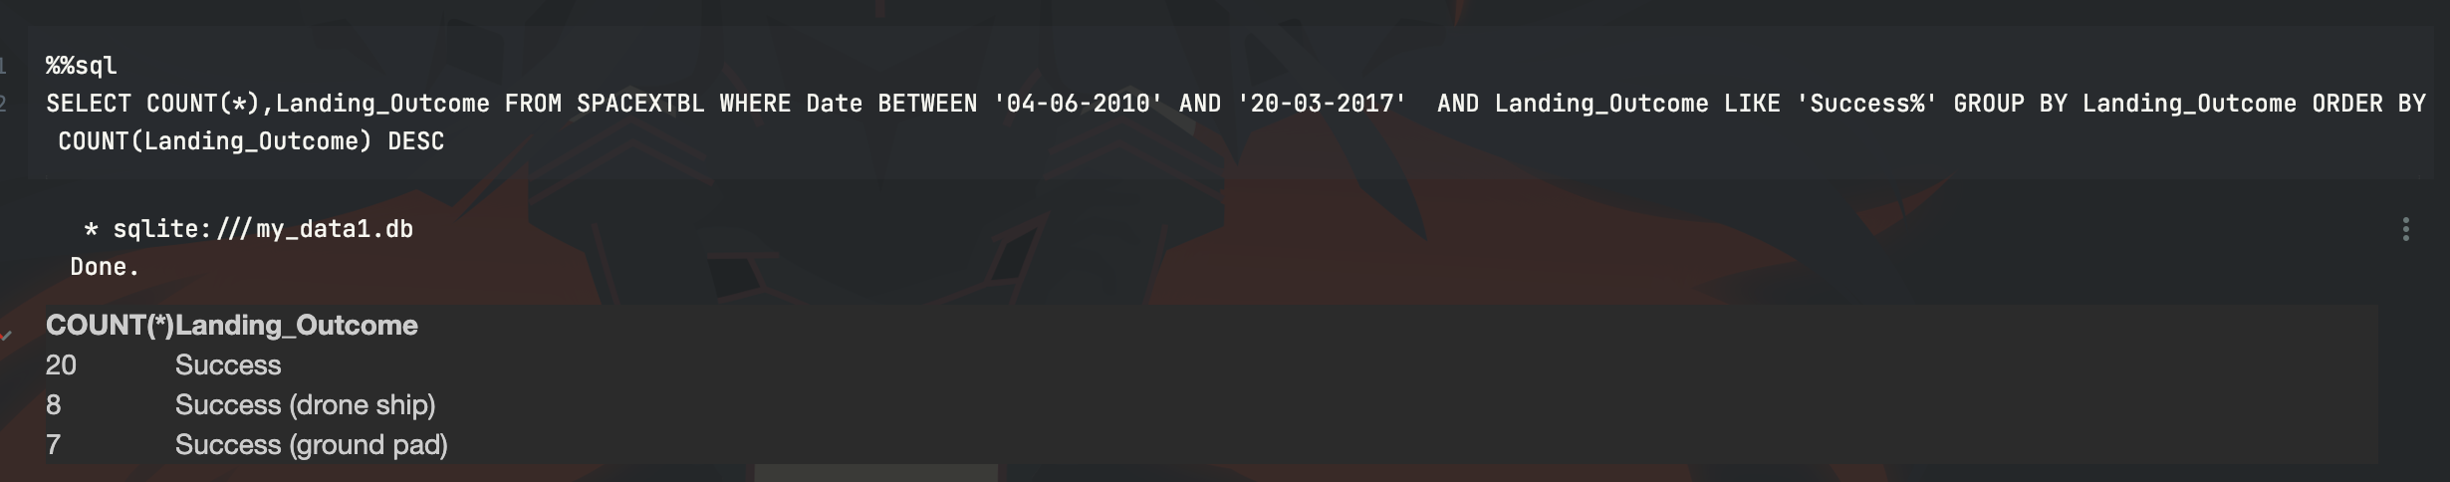
Rank Landing Outcomes Between 2010-06-04 and 2017-03-20
- Use group by and order by to get the rank landing outcomes

Slide 34

Section 3

Slide 35
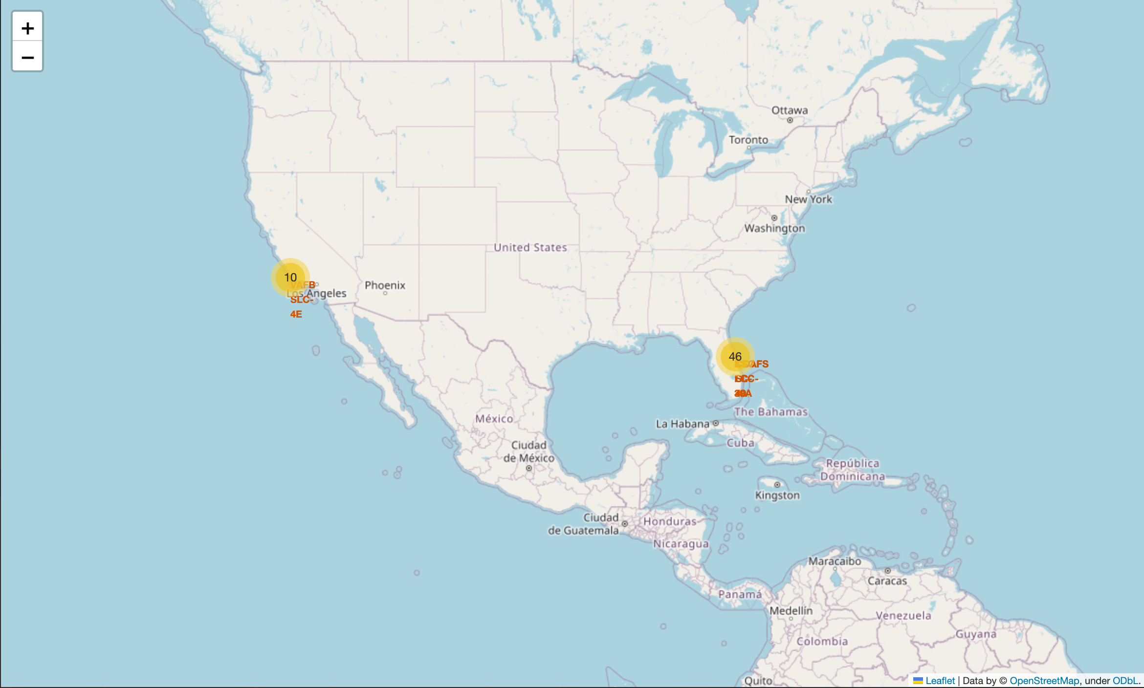
Launch sites with markers
-Launch sites are marked with markers and
Displayed to the map

Slide 36
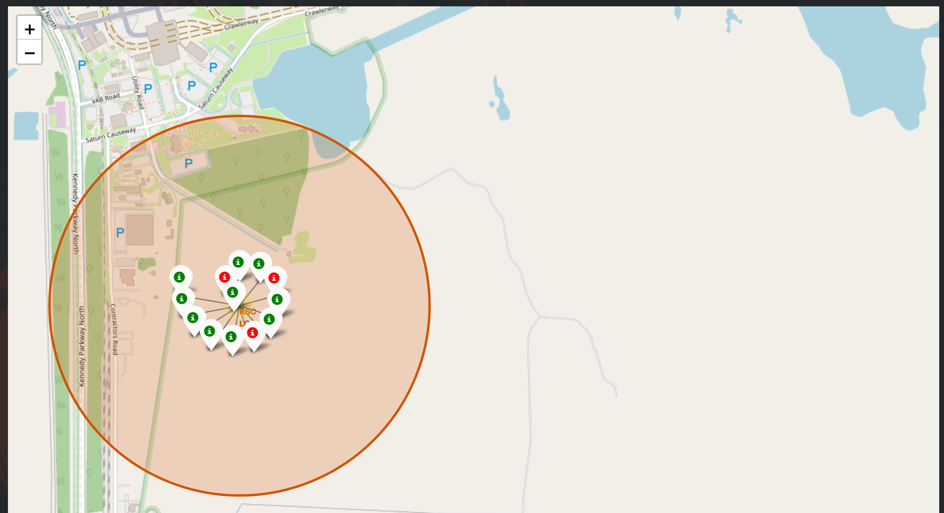
Launch outcomes marker
-Green markers used to display
Successful launches
-Red markers used to display
Failed launches
-KSC LC-39A has a good success
Rate according to the map

Slide 37
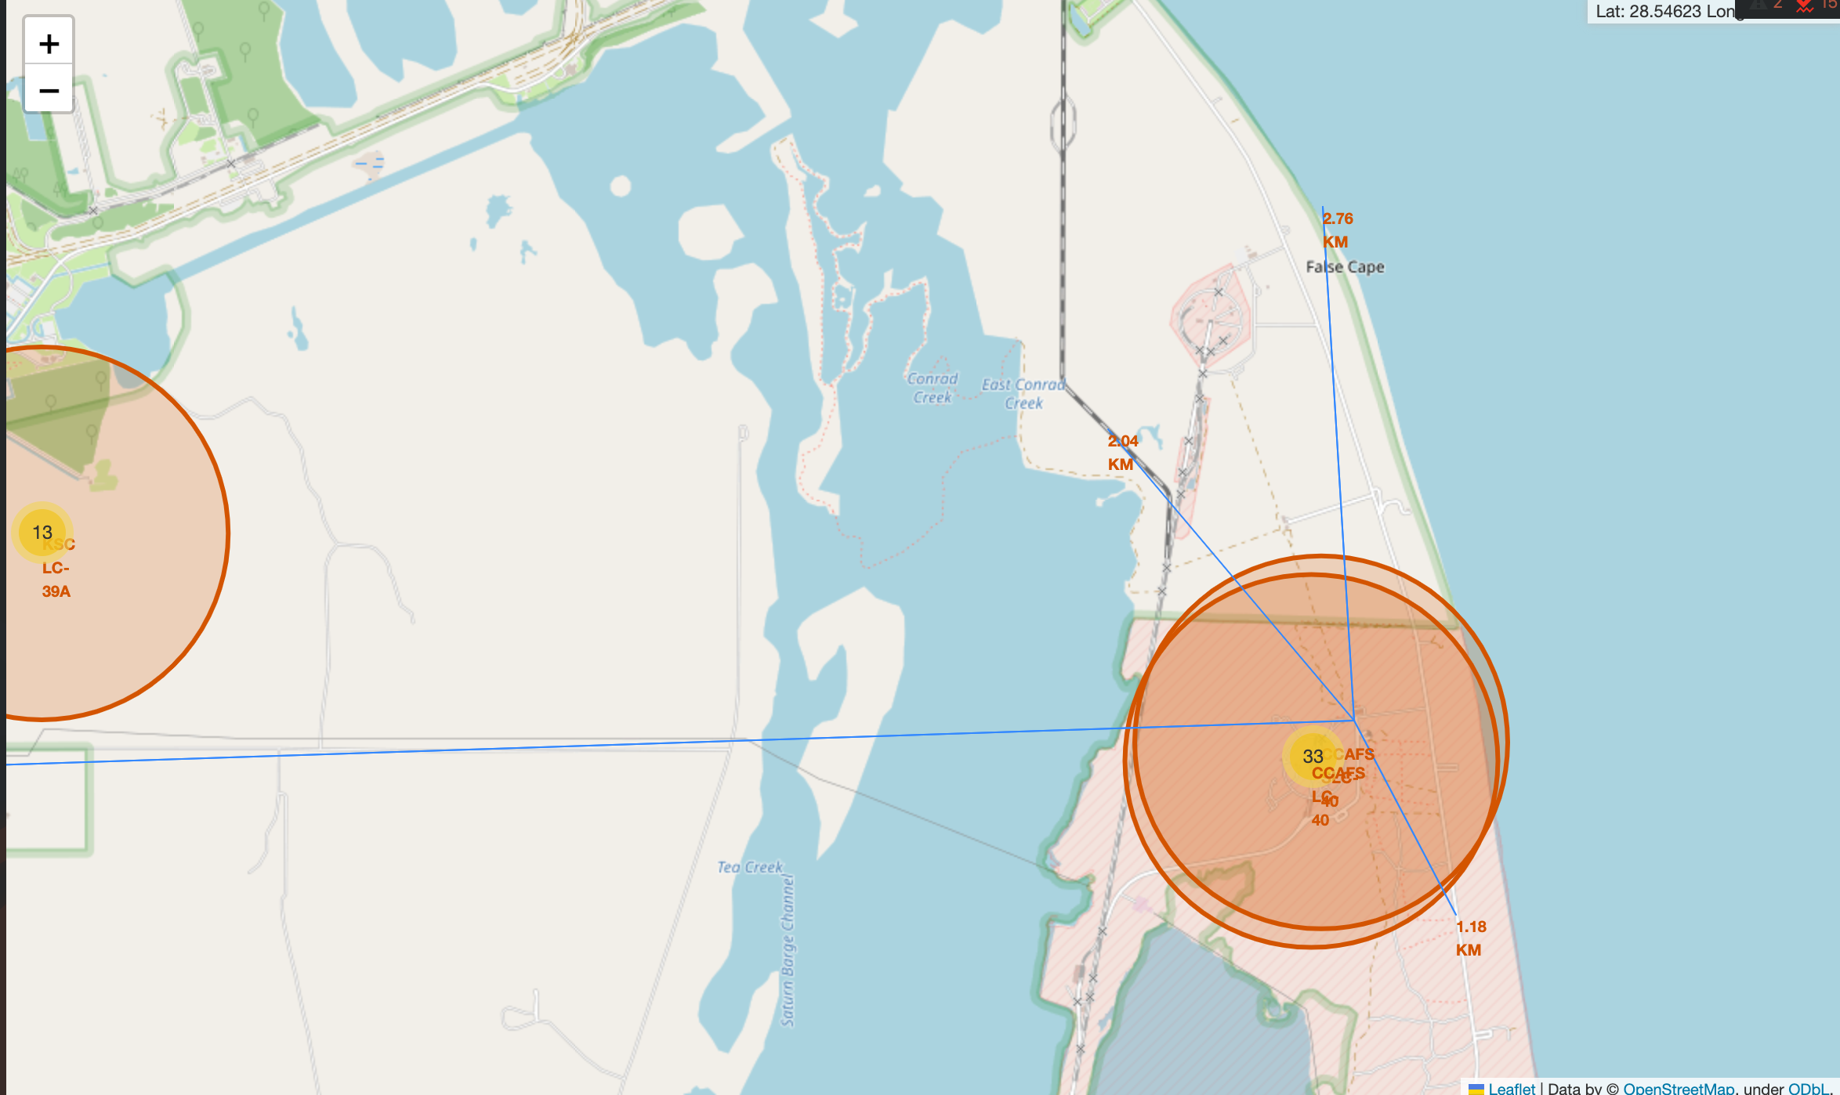
Distance from launch sites
-Launch sites are built near coastline
-Far from city
-Far from railway
-Far from highway

Slide 38

Section 4

Slide 39
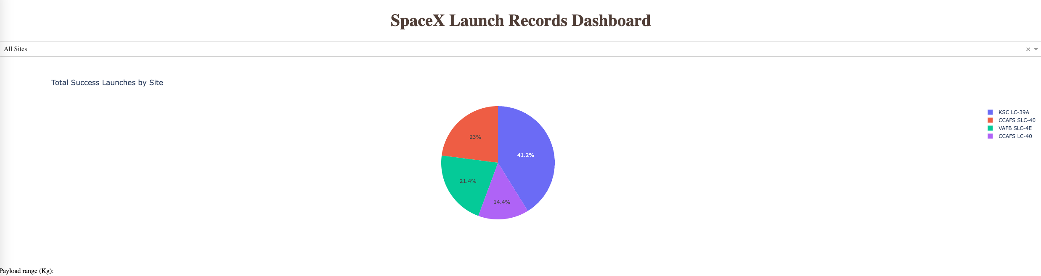
Success rate of all launch sites
-KSC LC-39A has the highest success rate
-CCAFS LC-40 has the lowest success rate

Slide 40
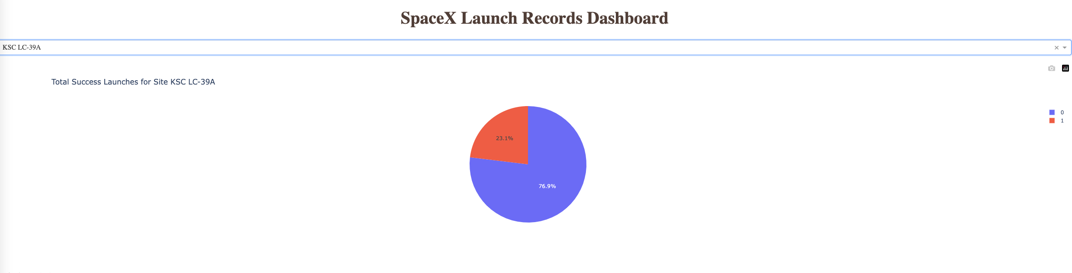
Success/Failure Rate of KSC LC-39A
-76.9% of launches in this landing sites are succeeded
-23.1% of launches in this landing sites are failed

Slide 41
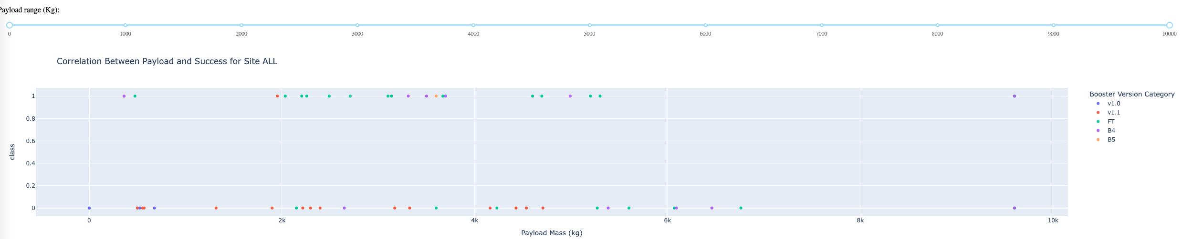
Correlation between success rate and payload
-There are 1 mission failed with payload = 0
-Payload between 2000 to under 6000 has the lowsest success rate across launches

Slide 42

Section 5

Slide 43
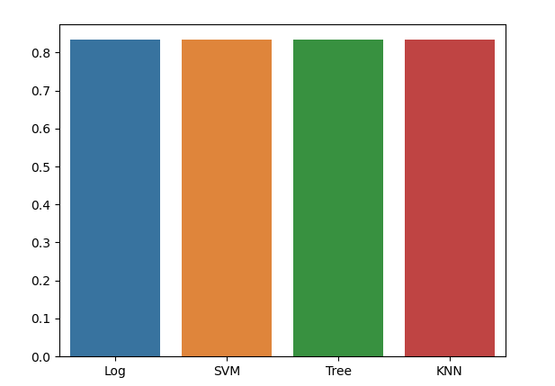
Classification Accuracy
According to the tests, all models perform
The same with the same dataset
The accuracy for all these models are 83,33%
Decision tree has the highest value of accuracy
87,5% for the train dataset

Slide 44
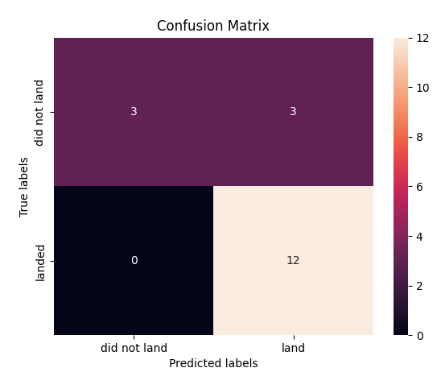
Confusion Matrix
12 True positive
3 True negative
0 False Negative
3False Positve
Precision=0.8
Recall=1
F1=0.89
Accuracy = 0,83

Slide 45
Conclusions
Model performed the same with the test set
All launch sites are close to the coast
Launch success increase over time
KSC LC-39A Has the highest success rate
Orbit ES-L1,GEO,HEO,SSO have 100% successs rate

Slide 46


